Slide 1
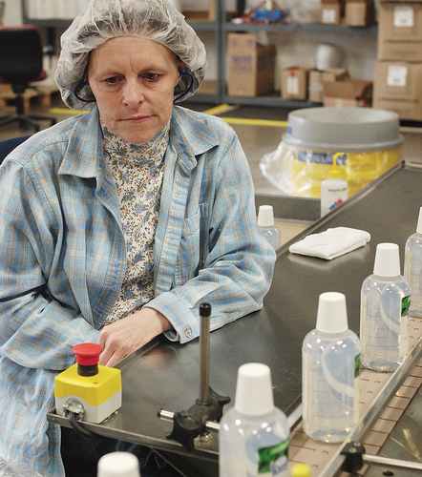
Evaluating Architectures
Quality control: rarely fun, but always necessary
http://www.flickr.com/photos/pierrelaphoto/2314190563/

Slide 2
But first, some logistics
HW requirements
(new) Process
HW available by Monday
Tue, we discuss in Class
If any clarifications, we do so on Thu
HW4??
More design – coupling/cohesion/ class diagram/ design patterns….
Extra credit???
Take 4 points from HW4 – spread it to HW3, HW5, HW6, HW7
Make due date flexible – until TG weekend
Notes:
Page limits
Reuse/ rework on things from previous parts

Slide 3
Upcoming important dates
H3 – Architecture
Due: 10/31
Vision V3 – due Tue: 11/3
Midterm
11/12 – in class.
Open book, everything – but please don’t plagiarize/ copy
Note that HW5 is due the Saturday – so plan and prepare ahead
HW 5 – User stories, agile. Etc.
Due: 11/4
Notes:
Page limits
Reuse/ rework on things from previous parts

Slide 4
Homework 3 (requirements review)
In this assignment, you will design the architecture for your system.
Describe the high-level architecture of your system. Specify the function of each component and add a diagram describing how they connect. (approx 1 page)
Describe an alternate high-level architecture of your system; this alternate architecture should have a different architectural style than your first architecture. Again, specify the function of each component and add a diagram describing how they connect. (approx 1 page)
Select one of your two architectures for further decomposition. Identify two important elements in your selected architecture, and for each element, give a lower-level dataflow diagram. (approx 2 pages)
Identify the key quality attributes for your system and assess how well each of the two architectures supports each quality attribute (approx 1 page)
Identify two failure modes; for each mode, explain which of your two architectures is probably more prone to failure (and why) (approx 2 pages)
Notes:
How to draw diagrams

Slide 5
Brief overview of Architecture
Architecture = shows pieces of a system & their relationships
Component = self-contained piece of a system, with clearly-defined interfaces and structure
Connector = a linkage between components via an interface

Slide 6
Architecture Styles
An architectural style defines a family of systems in terms of a pattern of structural organization. More specifically, an architectural style defines a vocabulary of components and connector types, and a set of constraints on how they can be combined
Pipe and Filter
Repository Architecture (blackboard)
Event Driven (broadcast, interrupt driven)
Layered
MVC
Client Server -> service based architecture
Restful Architecture
P2P

Slide 7
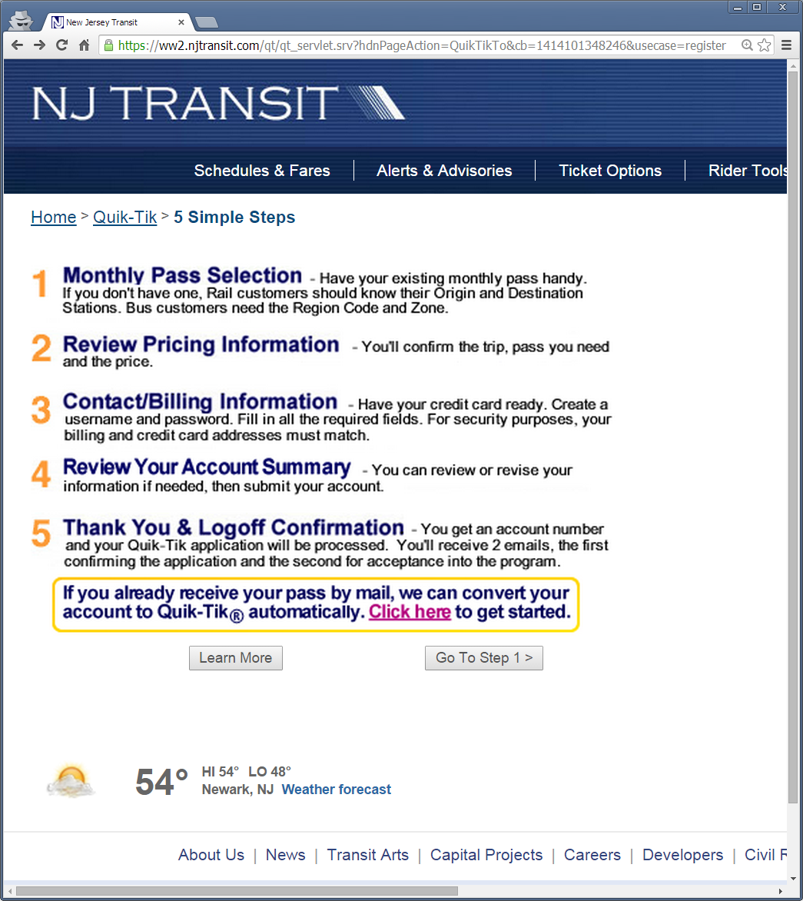
Example: A real system used by millions of customers every month

Slide 8
UC#1: Sign-up
Actor: user on internet
Preconditions: user has credit card and browser
Postconditions: login & purchase info stored
Flow of events: User visits web site
User fills out login info
User fills out purchase info
Website stores to server repository

Slide 9
UC#2: Edit purchase
Actor: user on internet
Preconditions: user has existing account
Postconditions: updated purchase info stored
Flow of events: User logs into web site
User updates purchase info
Website stores to server repository

Slide 10
High-level data flow diagram
User
Login Info
Website
Purchase Info
Server Repo
Purchase Info
Login Info
User DB
Notice that the “function” ovals are usually omitted in data flow diagrams for architectures. Note: all of the diagrams for this system represent a simplified version of the architecture.

Slide 11
How to draw an Architecture

Slide 12
Homework 3 (requirements review)
In this assignment, you will design the architecture for your system.
Describe the high-level architecture of your system. Specify the function of each component and add a diagram describing how they connect. (approx 1 page)
Describe an alternate high-level architecture of your system; this alternate architecture should have a different architectural style than your first architecture. Again, specify the function of each component and add a diagram describing how the connect. (approx 1 page)
Select one of your two architectures for further decomposition. Identify two important elements in your selected architecture, and for each element, give a lower-level dataflow diagram. (approx 2 pages)
Identify the key quality attributes for your system and assess how well each of the two architectures supports each quality attribute (approx 1 page)
Identify two failure modes; for each mode, explain which of your two architectures is probably more prone to failure (and why) (approx 2 pages)
Notes:
Also announce about group submissions
Why the page limit.

Slide 13
Architecture Decomposition

Slide 14
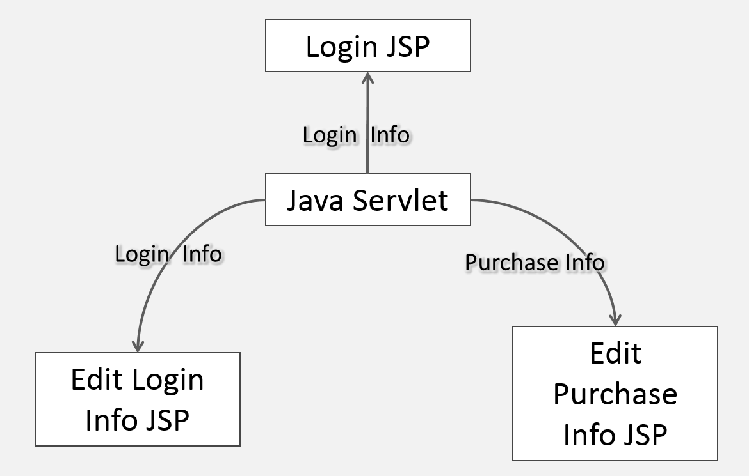
Decomposition: providing a detailed view of a component
Decomposition of the “website” component Typical J2EE system: Servlet passes data to JSP, which displays it; browser posts back to servlet
Login JSP
Login Info
Java Servlet
Login Info
Purchase Info
Edit Purchase Info JSP
Edit Login Info JSP

Slide 15
Approaches for decomposing an architecture
Functional decomposition
Data-oriented decomposition
Object-oriented decomposition
Process-oriented decomposition
Feature-oriented decomposition
Event-oriented decomposition

Slide 16
Functional decomposition
Break each requirement into functions, then break functions recursively into sub-functions
One component per function or sub-function
Each function computationally combines the output of sub-functions
E.g.: ticket_price = fee(station₁) + fee(station₂) + distance_fee(station₁ , station₂) + fuel_surcharge(station₁ , station₂)

Slide 17
Functional decomposition
Requirement
Requirement
Requirement
Function 1
Function 2
Sub-function A
Sub-function B
Sub-function C
Sub-function x
Sub-function y
Sub-function z
System Boundary

Slide 18
Data-oriented decomposition
Identify data structures in requirements, break data structures down recursively
One component per data structure
Each data structure contains part of the data
E.g.: Purchase info = Ticket info and billing info; ticket info = two stations and a ticket type; billing info = contact info and credit card info; contact info = name, address, phone, …; credit card info = type, number, expiration date

Slide 19
Data-oriented decomposition
Requirement
Requirement
Requirement
Data Struct A
Data Struct B
Data Struct C
Data Struct D
Data Struct E
Data Struct F
Data Struct G
Data Struct H
System Boundary

Slide 20
Object-oriented decomposition
Identify data structures aligned with functions in requirements, break down recursively
One class component per data+function package
Each component contains part of the data+fns
OO decomposition essentially is the same as functional decomposition aligned with data decomposition

Slide 21
Object-oriented decomposition
Requirement
Requirement
Requirement
Class A
Class B
Class C
Class D
Class E
Class F
Class G
Class H
System Boundary

Slide 22
Process-oriented decomposition
Break requirements into steps, break steps into sub-steps recursively
One component per sub-step
Each sub-step completes one part of a task
E.g.: one component to authenticate the user, another to display purchase info for editing, another to store the results away

Slide 23
Process-oriented decomposition
Requirement
Process step A1
Process step A2
Process step A3
Requirement
Process step B1
Process step B2
Process step B3
Requirement
Process step X4
Process step C1
Process step C2
Process step C3
System Boundary

Slide 24
Feature-oriented decomposition
Break each requirement into services, then break services into features
One component per service or feature
Each feature makes the service “a little better”
E.g.: service does basic authentication, but one feature gives it a user interface, another feature gives it an OpenID programmatic interface, another feature gives it input validation, and another feature does logging

Slide 25
Feature-oriented decomposition
Requirement
Requirement
Requirement
Service 1
Service 2
Feature 1a
Feature 2a
Feature 1b
Feature 2b
Feature 1c
Feature 2c
Feature 2d
System Boundary

Slide 26
Event-oriented decomposition
Break requirements into systems of events, recursively break events into sub-events and state changes
Each component receives and sends certain events, and manages certain state changes
Each component is like a stateful agent
E.g.: in the larger ticketing system, the mainframe signals the ticket printing system and the credit card company; the ticket printer notifies server repository when it mails ticket to user

Slide 27
Event-oriented decomposition
Requirement
Requirement
Component B
Component A
Component C
Component D
Component F
Component E
System Boundary

Slide 28
Four basic ways to evaluate architectural designs
Compare against desired quality attributes
Check for problematic failure modes
Walk through use cases
Verify conformance to checklist of principles
The goal is NOT to “prove” that the architecture is perfect, but rather to identify opportunities for improvement.

Slide 29
Homework 3 (requirements review)
In this assignment, you will design the architecture for your system.
Describe the high-level architecture of your system. Specify the function of each component and add a diagram describing how they connect. (approx 1 page)
Describe an alternate high-level architecture of your system; this alternate architecture should have a different architectural style than your first architecture. Again, specify the function of each component and add a diagram describing how they connect. (approx 1 page)
Select one of your two architectures for further decomposition. Identify two important elements in your selected architecture, and for each element, give a lower-level dataflow diagram. (approx 2 pages)
Identify the key quality attributes for your system and assess how well each of the two architectures supports each quality attribute (approx 1 page)
Identify two failure modes; for each mode, explain which of your two architectures is probably more prone to failure (and why) (approx 2 pages)
Notes:
How to draw diagrams

Slide 30
Quality attributes of great software
Reliability
Efficiency
Integrity
Usability
Maintainability
Testability
Flexibility
Portability
Reusability
Interoperability
Notes:
Reliability
Efficiency
Integrity
Usability
Maintainability

Slide 31
Checking against quality attributes
Maintainability (includes modifiability)
How hard will it be to make anticipated changes?
Efficiency (includes performance)
Can the system respond quickly, do a lot of work per unit time, and scale to high loads?
Reliability
Will it perform properly under assumed conditions?
Integrity (includes security)
Is it possible put the system into a bad state?
Usability
Can real users complete their goals with the system?

Slide 32
Checking against quality attributes
Testability
Can you (semi-)automatically test if the system is right?
Flexibility (includes robustness)
How easily can the system adapt to unusual conditions?
Portability
Could you get the system to run on a new platform?
Reusability
What parts of the system could you use in a new system?
Interoperability
Can the system talk to other relevant systems?

Slide 33
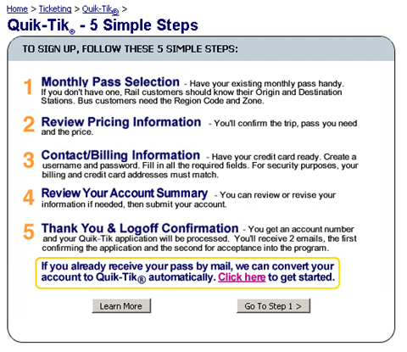
Example system
User
Java Servlet
Server repo
User DB
Login JSP
Edit Login Info JSP
Edit Purchase Info JSP

Slide 34
Checking example system against key quality attributes
Integrity: security
Are all communications and databases encrypted?
Is credit card info stored in any risky location?
Integrity: another consideration
What happens when a credit card expires?
Efficiency
What platform is used to run the servlet & JSPs? What throughput and response time is likely?

Slide 35
Homework 3 (requirements review)
In this assignment, you will design the architecture for your system.
Describe the high-level architecture of your system. Specify the function of each component and add a diagram describing how they connect. (approx 1 page)
Describe an alternate high-level architecture of your system; this alternate architecture should have a different architectural style than your first architecture. Again, specify the function of each component and add a diagram describing how they connect. (approx 1 page)
Select one of your two architectures for further decomposition. Identify two important elements in your selected architecture, and for each element, give a lower-level dataflow diagram. (approx 2 pages)
Identify the key quality attributes for your system and assess how well each of the two architectures supports each quality attribute (approx 1 page)
Identify two failure modes; for each mode, explain which of your two architectures is probably more prone to failure (and why) (approx 2 pages)
Notes:
How to draw diagrams

Slide 36
Four basic ways to evaluate architectural designs
Compare against desired quality attributes
Check for problematic failure modes
Walk through use cases
Verify conformance to checklist of principles
The goal is NOT to “prove” that the architecture is perfect, but rather to identify opportunities for improvement.

Slide 37
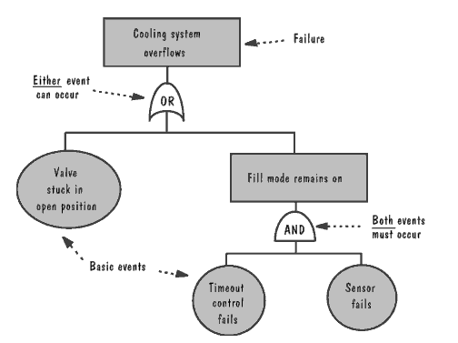
Checking against failure modes
What does it take to cause a “very bad thing”?
Software Engineering, Pfleeger, 3rd Edition

Slide 38
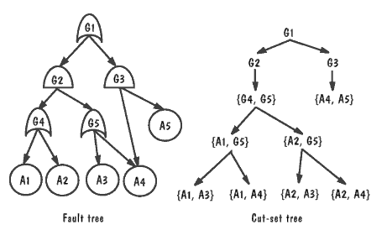
Checking against failure modes
Trace the basic events through the “AND” and “OR” gates of the fault tree.
Software Engineering, Pfleeger, 3rd Edition

Slide 39
Checking against failure modes
G1: Credit card theft
Note: This tree isn’t exhaustive; it’s just what fits one 1 slide for illustrative purposes.
G2: Steal credentials
G3: Man-in-middle
G4: Steal from data store
A1: Unencrypted connection
A3: Compromised servlet
A4: Unencrypted data from store
A2: Sniffer

Slide 40
Strengths and weaknesses of alternate architectures
Would the risk of a security breach failure mode have been higher in a peer-to-peer architecture that extended beyond our intranet? Maybe.
But for a file-sharing system, total system blackout might be the failure mode of concern, in which case peer-to-peer might reduce the risk of failure
Quality attributes: Would performance have been improved by a system fully was implemented as service based architecture?
But would interoperability have been reduced?

Slide 41
Four basic ways to evaluate architectural designs
Compare against desired quality attributes
Check for problematic failure modes
Walk through use cases
Verify conformance to checklist of principles
The goal is NOT to “prove” that the architecture is perfect, but rather to identify opportunities for improvement.

Slide 42
Walk through use cases
Methodically step through each use case
Are all the necessary components in the system?
Are they connected correctly?
Are all your arrows pointing the right direction?
Does the system enact the right state changes?
Does performing a use case prevent subsequently performing any other use cases?

Slide 43
Having a sequence diagram really helps to prevent surprises
User
Servlet
Edit Login Info JSP
Edit Purchase Info JSP
User DB
Mainframe
Visit site
[username and password are valid]
Login info (starts empty)
Username & password
[purchase information is valid]
Purchase info (starts empty)
Purchase info
Login info
Purchase info

Slide 44
Four basic ways to evaluate architectural designs
Compare against desired quality attributes
Check for problematic failure modes
Walk through use cases
Verify conformance to checklist of principles
The goal is NOT to “prove” that the architecture is perfect, but rather to identify opportunities for improvement.

Slide 45
Verify conformance to checklist (Has a lot in common w/ quality attrs!)
Is the architecture modular, well structured, and easy to understand?
Can we improve the structure and understandability of the architecture?
Is the architecture portable to other platforms?
Are aspects of the architecture reusable?
Does the architecture support ease of testing?
Does the architecture maximize performance, where appropriate?
Does the architecture incorporate appropriate techniques for handling faults and preventing failures?
Can the architecture accommodate all of the expected design changes and extensions that have been documented?

Slide 46
Example system from last lecture
User
Java Servlet
Server Repo
User DB
Login JSP
Edit Login Info JSP
Edit Purchase Info JSP

Slide 47
Checking example system vs. checklist
Modular?
“User DB” is a big black box. May need data-oriented decomposition.
“Mainframe” may need decomposition, too.
Understandable?
Interaction among servlet and JSP is probably unclear to some programmers. May need some textual specification.
Testable?
It depends on how fancy the JSP’s HTML is. (DHTML?)
Mainframe is fully testable.
Performance?
See earlier discussion regarding quality attributes.

Slide 48
Checking example system vs. checklist
Portable?
Not at all. Do we care? It depends.
Reusable?
Probably only the data. Do we care? It depends.
Further decomposition might identify more reusable parts.

Slide 49
Checking example system vs. checklist
Fault handling & failure prevention?
Need to keep people from entering invalid data.
May need server redundancy.
All data should be backed up.
Encrypt communications + data in databases.
Security audit of system?
More consideration will be needed after the implementation is designed.

Slide 50
Checking example system vs checklist
Maintainable?
Separating user interface code into JSPs generally improves maintainability.
But adding new fields requires changes in many places (e.g.: adding another field to purchase info, requires updating the servlet, JSP, and mainframe)
Object-oriented decomposition could have avoided this particular problem in this situation.

Slide 51
Take note of opportunities for improvement
Encrypt database and connections
Improve use case & sequence diagram to cover situations where credit card expires
Decompose the database and mainframe
Decompose servlet, looking for reusable parts

Slide 52
Consider tradeoffs
Use DHTML in HTML from JSP?
Might improve usability
Might hinder testability
Specify server redundancy?
Might improve fault tolerance and performance
Might hinder integrity (keeping servers in sync)
Move to object-oriented decomposition?
Might improve maintainability
Might hinder interoperability (legacy mainframe)

Slide 53
What’s next for you?
Work on HW3 (due Sat – 10/31)
Vision V3 due Tue – 11/3

